Slide 1
Unit 3 For Live Session Assignment
Isabella Westlauer
2/9/2026

Slide 2
Analysis of FIFA Dataset

Slide 3
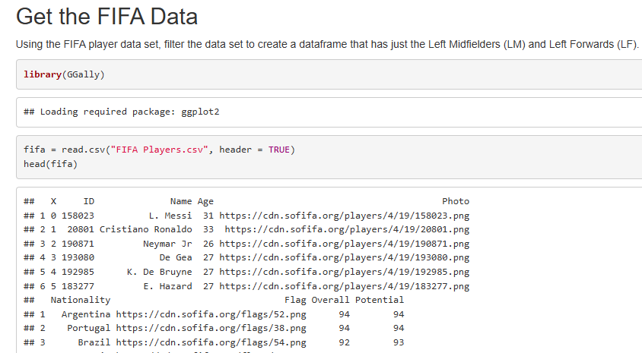
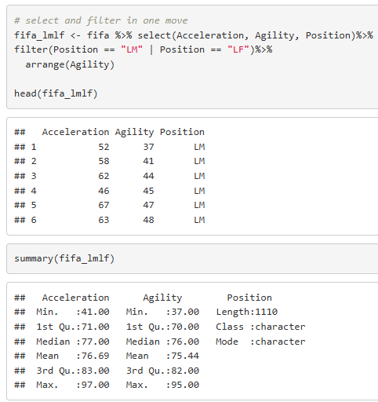
Notes:
Part 1: We would like to analyze the Left Midfielders (LM) versus the Left Forwards (LF). (Estimated / expected time: 2 – 4 hours and at least 2+ slides).
Using the FIFA player data set, filter the data set to create a dataframe that has just the Left Midfielders (LM) and Left Forwards (LF).

Slide 4
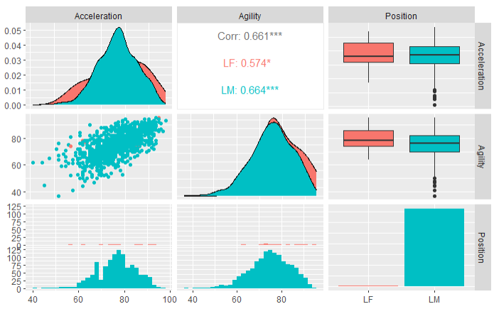
Acceleration and Agility of Left Midfielders (LM) and Left Forwards (LF)
Significantly more LM than LF samples in the dataset
Ratings are similar between positions, but LM shows left skew
Ratings have an IQR between 60-90
Note a positive covariance between acceleration and agility for both positions
Notes:
Use Ggally and ggpairs() and the dataset you created above above, to plot the categorical variable Position (LM and LF), versus the continuous variables Acceleration and Agility.
Given the plot above, what relationships do you see? Comment on these.
Notice the long dotted tail on the box plots for LM
Positive trend on the scatterplot
Distribution hard to compare on the histogram between LF and LM because of varying sample sizes

Slide 5
Agility Rating of Left Midfielders vs Left Forwards
Two-sample t-test
Notes:
Your client would like to formally test if the mean agility rating of left midfielders is different than that of the left forwards. Perform a 6 – step t-test to test for the difference in these means. (You may skip step 2 (draw and shade) if you like. If you are unfamiliar with the 6-step hypothesis test, see Stat 1 slides or the Bridge Course to review the 6-step hypothesis test.)
State the hypotheses (Null and Alternative)
H0 : AgilityLM = AgilityLF (they have the same agility rating)
Ha: AgilityLM != AgilityLF (they have different agility ratings)
Critical value/ draw and shade default alpha is .05 – there a critical value plot in R studio?
How do we know where to put those bars? The xbar is agilitylm – agilitylf
draw a curve and put the boundary on either side?
assume stdev = 2? Every assumption adds more uncertainty. Find the stdev of each sample and use a pooled sigma
z score is the number of stdevs away from the mean, z = (x-mu)/stdev
Choose test statistic, an approximation to the normal distribution, find fmla in bridge to stat
From our data sample, the fifa dataset, the Mean agility of LM = ___ and the mean agility of LF = ____
How do I choose test statistic for a two-sample t-test? Use the formula
Stdev(lm) – stdev(lf) assume they are equal for the test, pool them together, using the weighted equation (see the png)
n(lm) – n(lf)
The t stat is the number of stdev our evidence is from 0
P Value
What is the likelihood that our sample would show Ha, if H0 were true?
How do we calculate the p value? The area under the curve beyond the tstat. The calculation is integration by parts, or a table lookup based on T score. Use an R function to calculate it?
Run t.test in r
Look up welch two-sample t-test
Decision
Conclusion in client language
Are the assumptions of this test reasonably met? If you have not had Stat 1, simply create a histogram of the agility scores for both groups (LM and LF) and given what you know about the CLT, comment on if you believe the sampling distribution of sample means (of your sample size) will be reasonably normal. In addition, does there look like there is significant visual evidence to suggest the standard deviations are different? ….. If you have had Stat 1, create the plots listed above (and any other plots you might prefer) and be prepared to be a teacher and teach what you know about the assumptions of the t-test and if those are assumption are reasonably met here.

Slide 6
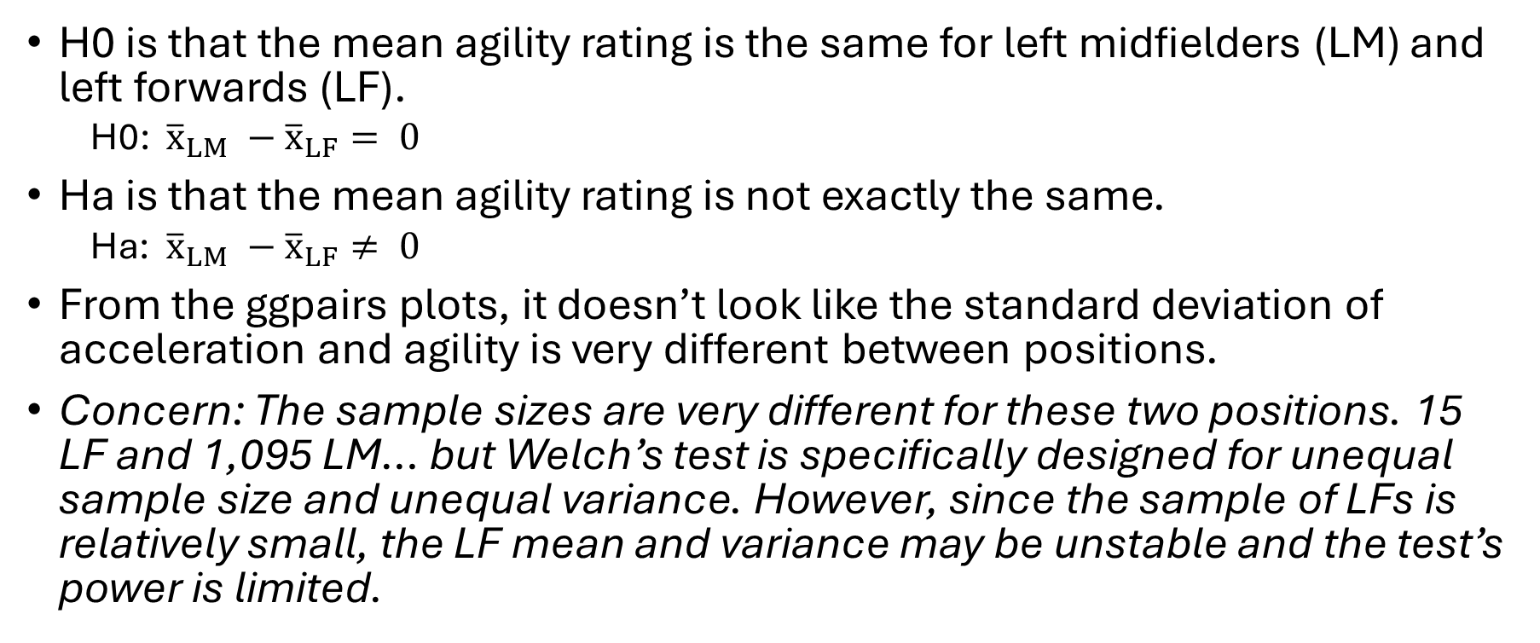
Step 1. Hypotheses
H0 is that the mean agility rating is the same for left midfielders (LM) and left forwards (LF).
H0: ${\overline{x}}_{LM} −{\overline{x}}_{LF}= 0$
Ha is that the mean agility rating is not exactly the same.
Ha: ${\overline{x}}_{LM} −{\overline{x}}_{LF}≠ 0$
From the ggpairs plots, it doesn’t look like the standard deviation of acceleration and agility is very different between positions.
Concern: The sample sizes are very different for these two positions. 15 LF and 1,095 LM… but Welch’s test is specifically designed for unequal sample size and unequal variance. However, since the sample of LFs is relatively small, the LF mean and variance may be unstable and the test’s power is limited.

Slide 7
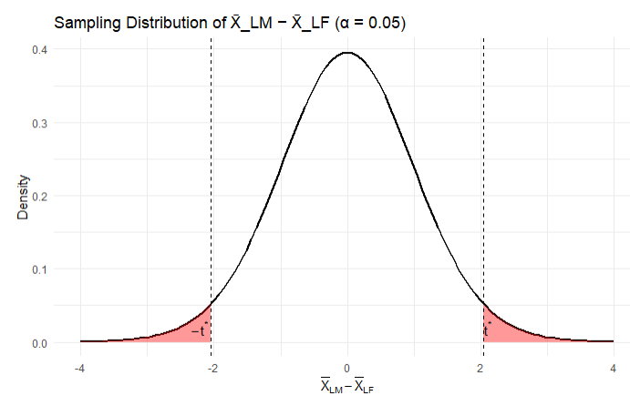
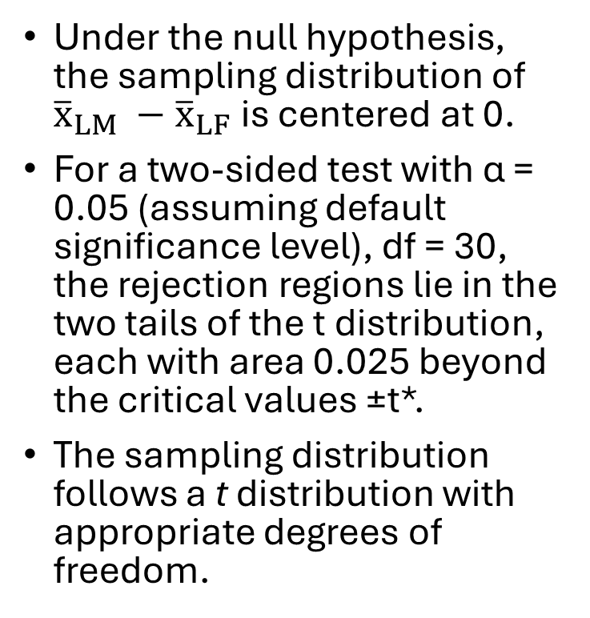
Step 2. Critical Value Draw and Shade
Under the null hypothesis, the sampling distribution of ${\overline{x}}_{LM} −{\overline{x}}_{LF}$is centered at 0.
For a two-sided test with α = 0.05 (assuming default significance level), df = 30, the rejection regions lie in the two tails of the t distribution, each with area 0.025 beyond the critical values ±t*.
The sampling distribution follows a t distribution with appropriate degrees of freedom.
Notes:
Assume alpha, the significance level is 0.05
The shaded area on the right side is alpha/2 = 0.025, as on the left side

Slide 8

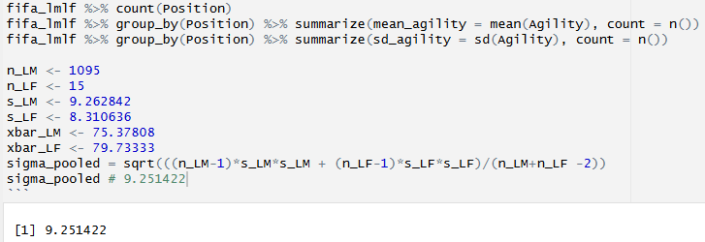
Step 3. Test Statistic for Two-Sample Test
First, pool the standard deviation for both samples

Slide 9

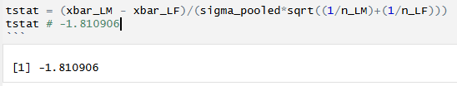

Step 3. Test Statistic for Two-Sample Test
Next, calculate the test statistic
$$t=±1.810906$$

Slide 10
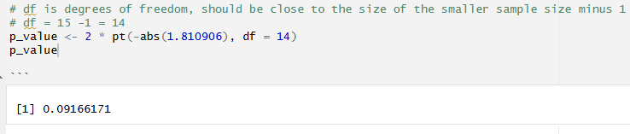
Step 4. P Value
Find the p-value: the probability of observing something as extreme or more extreme than what was observed, by random chance, under the assumption that the null hypothesis is true.
Using R to calculate the p-value, we see there’s about a 9% chance that our H0 is true.

Slide 11
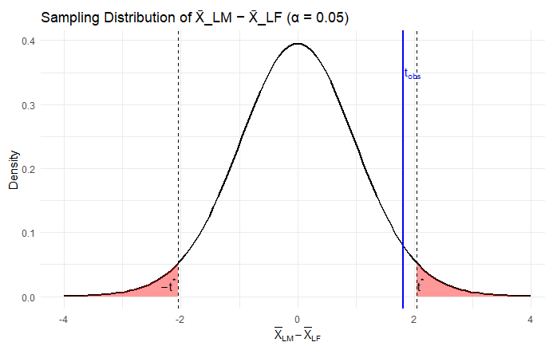
Step 5. Decision
Where does my observed statistic fall relative to the rejection regions? It falls inside the non-shaded area, so we fail to reject the null hypothesis.

Slide 12
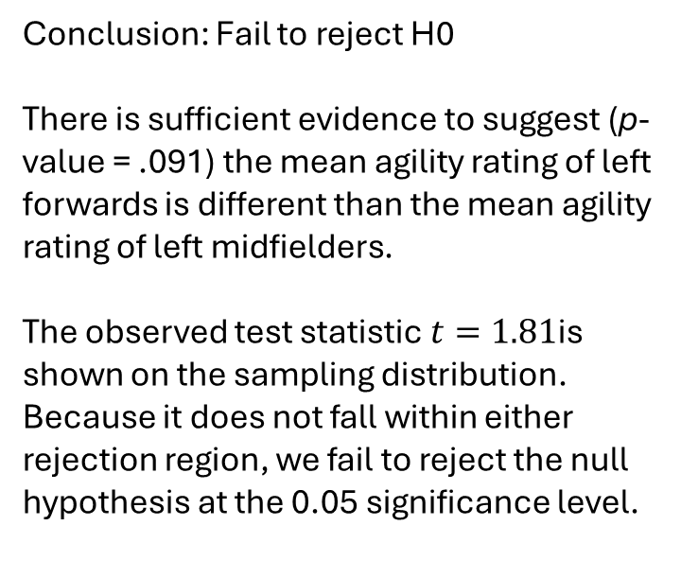
Step 6. Conclusion
Conclusion: Fail to reject H0 There is sufficient evidence to suggest (p-value = .091) the mean agility rating of left forwards is different than the mean agility rating of left midfielders. The observed test statistic $t=1.81$is shown on the sampling distribution. Because it does not fall within either rejection region, we fail to reject the null hypothesis at the 0.05 significance level.

Slide 13
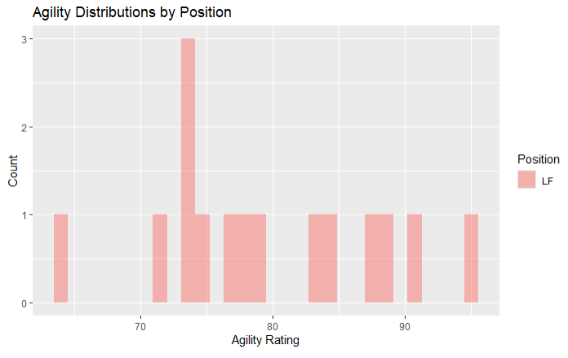
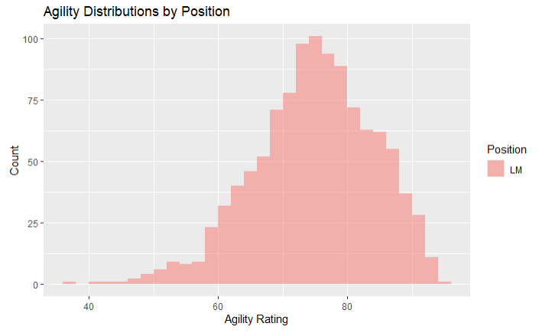
Are the assumptions of this test reasonably met?
The sampling distribution of sample means for sample size n=15 will not be reasonably normal, however for n=1095 it is reasonably normal. From the histograms, it is unclear whether the standard deviations are different.
Notes:
Are the assumptions of this test reasonably met? If you have not had Stat 1, simply create a histogram of the agility scores for both groups (LM and LF) and given what you know about the CLT, comment on if you believe the sampling distribution of sample means (of your sample size) will be reasonably normal. In addition, does there look like there is significant visual evidence to suggest the standard deviations are different? …..

Slide 14
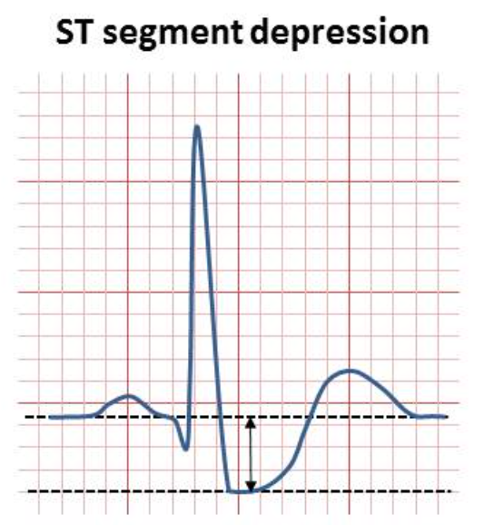
Dataset and Variables of Interest – Heart.csv
This dataset is derived from the UCI Heart Disease dataset, which aggregates clinical data collected from patients undergoing cardiac evaluation at several hospitals, including Cleveland Clinic and other international centers. The Kaggle version is a cleaned and consolidated subset commonly used for teaching EDA and classification methods.
Categorical Variables
“cp” is type of chest pain: Typical Angina= 0, atypical angina= 1, non-anginal pain= 2, asymptomatic= 3
“sex” is male: 0 or female: 1
Continuous Variables
“age” is the age in years, ranging from 29 to 77
“oldpeak” is proportional to the millimeters of ST depression induced by exercise relative to rest. ST depression reflects reduced blood flow to the heart muscle during stress, and larger depressions indicate more severe exercise-induced ischemia. Oldpeak ranges from 0 to 6.2

Slide 15
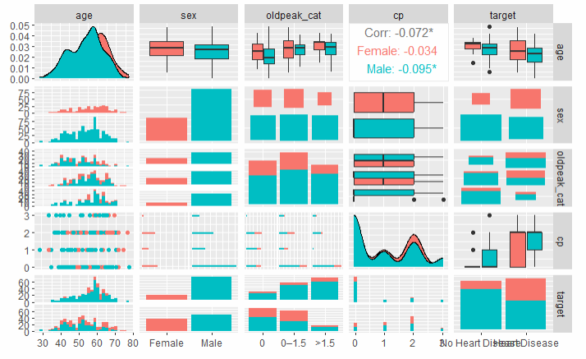
Ggpairs plots of 5 selected variables
Observations
There are more outliers in the age distribution of patients not diagnosed than diagnosed.
In the age histograms, the spread for those diagnosed is centered around a higher age than for those not diagnosed.
In the stacked bar plots of oldpeak, there is a positive correlation between the oldpeak value and the number of patients diagnosed.
In the stacked bar plot of target, it looks like a higher proportion of females are diagnosed with heart disease than males.
Notes:
Part 2: (Estimated / expected time 3-5 hours and at least 3+ slides)
Select/create at least 2 categorical variables and select two continuous variables and perform an EDA. Also, at least one of the categorical variables should be created from a continuous variable (using the cut() function).
Use these variables to explore the data and tell a story of what you discovered similar to what was shown in the asynch videos. You do not need to go so far as to use linear regression, but let your curiosity guide you along the way and feel free to use methods you are familiar with that are appropriate to answering those questions. Your evidence could be purely visual or could include additional methods, it is up to you… just do your best and have fun!

Slide 16
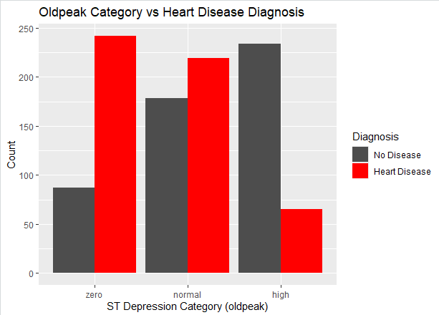
Why does this plot show the opposite of what I expected: that the patients diagnosed with heart disease were more likely to have a higher Oldpeak/ST Depression than those not diagnosed?
heart_df$oldpeak_cat <- cut( heart_df$oldpeak, breaks = c(-Inf, 0, 1.5, Inf), labels = c("zero", "normal", "high"))
It would be better to cut the breaks by the quartile range, instead of just choosing random values, but would that be a mistake?

Slide 17
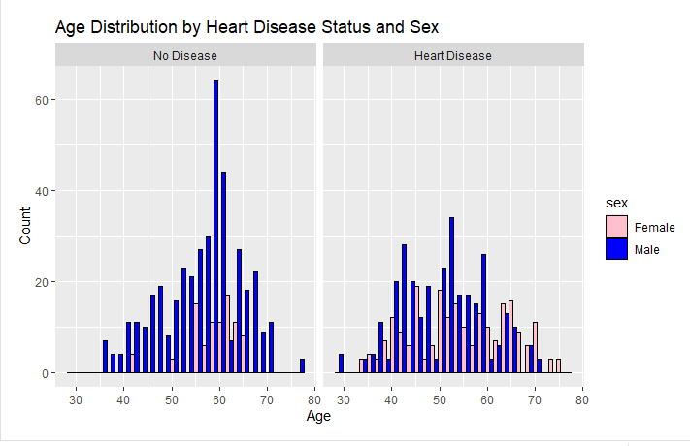
Comparison of Age Distribution
What is this comparison telling me?

Slide 18
Takeaways and Questions
What does a negative tstat mean? LM probably has a lower mean agility than LF?
Should we always choose degrees of freedom based on the sample size? I chose 14 here because the smaller sample size is 15.
Can an exploratory data analysis conclude with a bunch of additional questions about the data, or just a negative conclusion such as “I did not find any correlation between the variables of interest.”?

